Slide 2
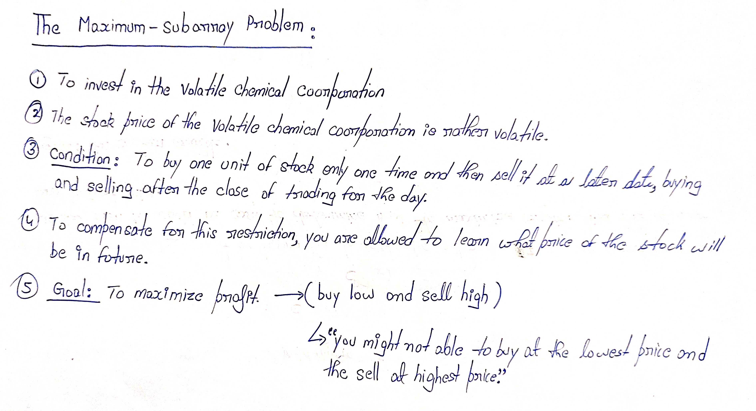

Slide 3
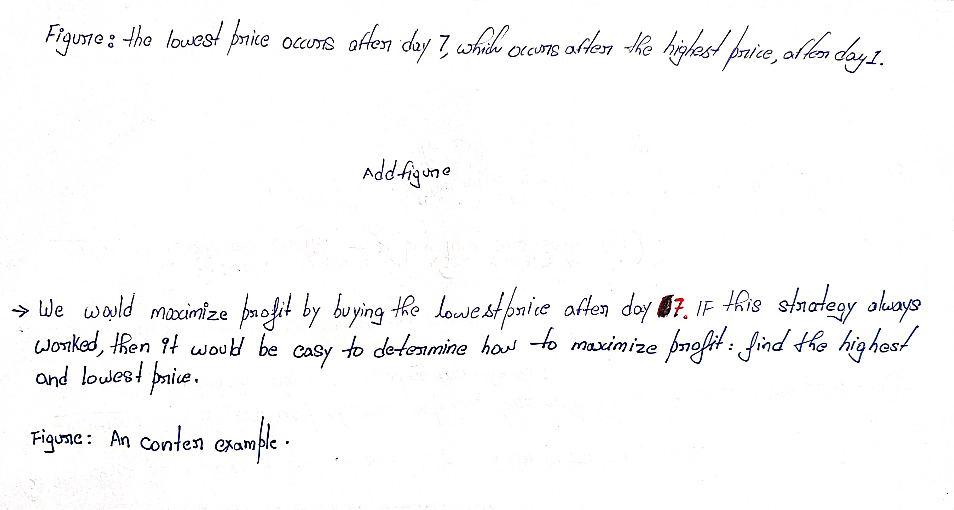
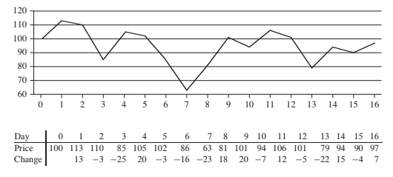

Slide 4
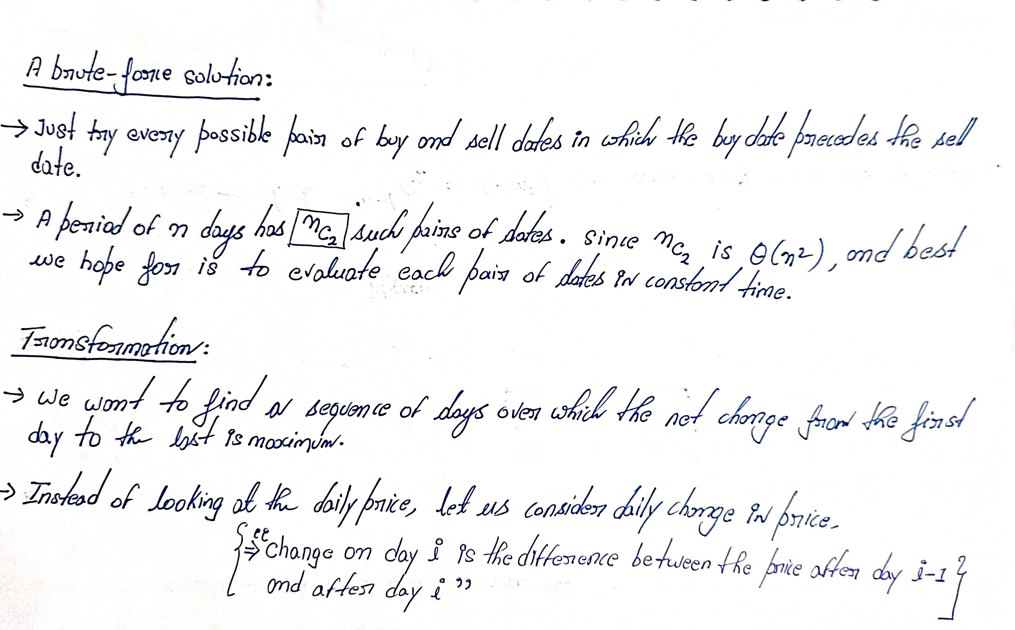

Slide 5
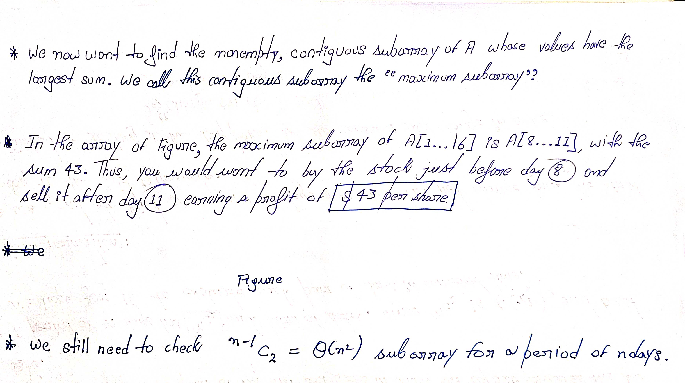

5

Slide 6
Maximum-sum contiguous subarray
Given an array A[ ] of n numbers, find the maximum sum found in any contiguous subarray
A zero length subarray has maximum 0
Example:
if A[ ] contains -2, 5, -3, 6, -1, then the maximum sum will be 5-3+6 = 8
if A[ ] contains 10, 15, -3, -4, -2, -1, 8, 5, then the maximum sum will be 28 (all numbers added together)
O(n²), O(n log n), O(n) time algorithms

Slide 7
Brute-force algorithm

Slide 8
Brute-force algorithm
All possible contiguous subarrays
A[1..1], A[1..2], A[1..3], ..., A[1..(n-1)], A[1..n]
A[2..2], A[2..3], ..., A[2..(n-1)], A[2..n]
...
A[(n-1)..(n-1)], A[(n-1)..n]
A[n..n]
How many of them in total?
Algorithm: For each subarray, compute the sum. Find the subarray that has the maximum sum.
O(n²)

Slide 9



Idea of brute-force algorithm
Example: 2 -6 -1 3 -1 2 -2
sum from A[1]: 2 -4 -5 -2 -3 -1 -3
sum from A[2]: -6 -7 -4 -5 -3 -5
sum from A[3]: -1 2 1 3 1
sum from A[4]: 3 2 4 2
sum from A[5]: -1 1 -1
sum from A[6]: 2 0
sum from A[7]: -2

Slide 10
Brute-force algorithm
Outer loop: index variable i to indicate start of subarray, for 1 ≤ i ≤ n, i.e., A[1], A[2], ..., A[n]
for i = 1 to n do ...
Inner loop: for each start index i, we need to go through A[i..i], A[i..(i+1)], ..., A[i..n]
use an index j for i ≤ j ≤ n, i.e., consider A[i..j]
for j = i to n do ...

Slide 11
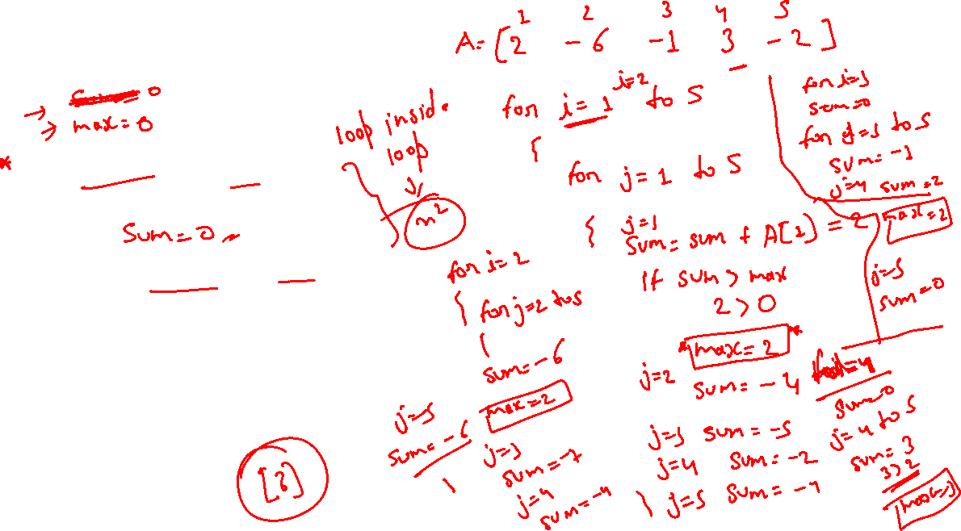
Pseudo code
Time complexity?
O(n²)
max = 0
for i = 1 to n do
begin
sum = 0
for j = i to n do
begin
sum = sum + A[j]
if sum > max
then max = sum
end
end

Slide 12
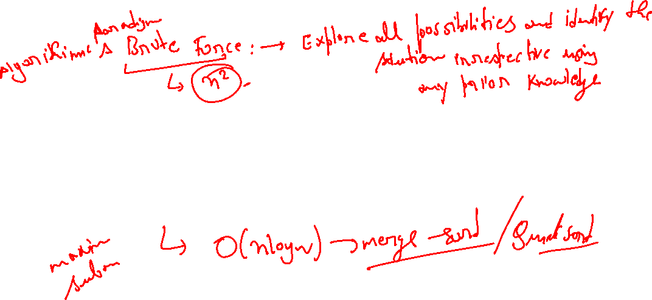
Divide-and-conquer algorithm

Slide 13
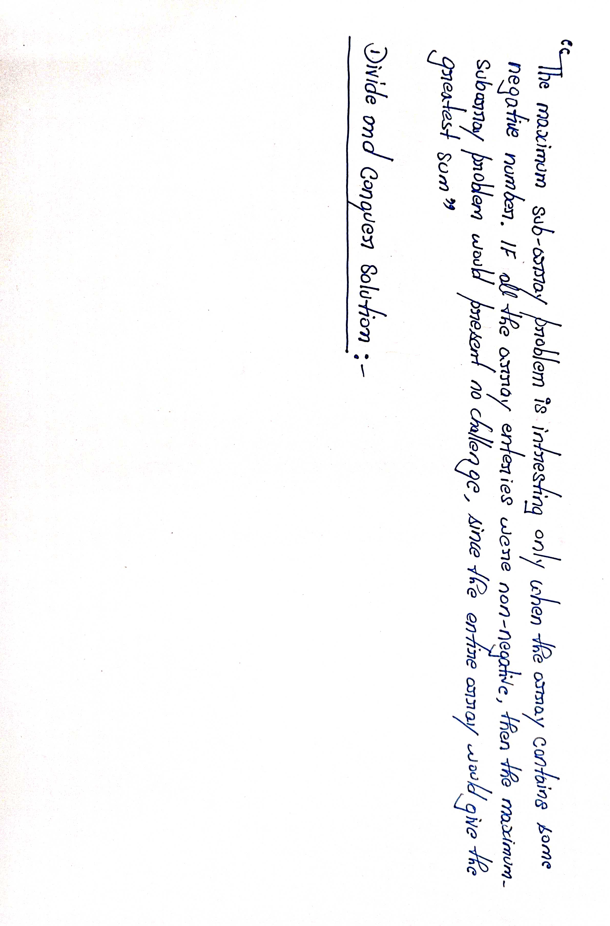

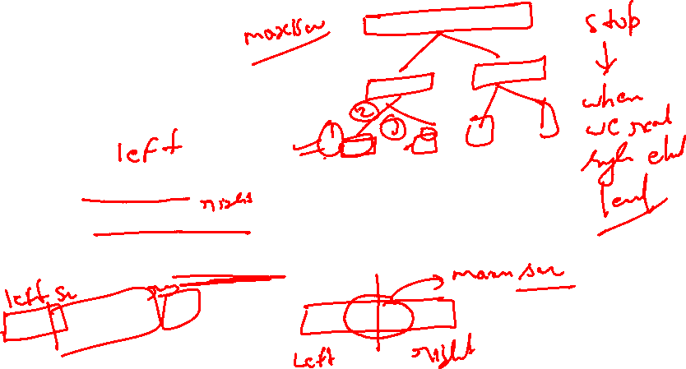

Slide 14
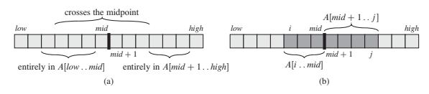
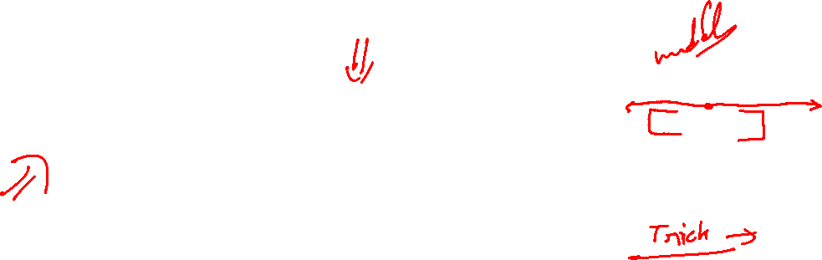

Slide 15




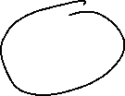

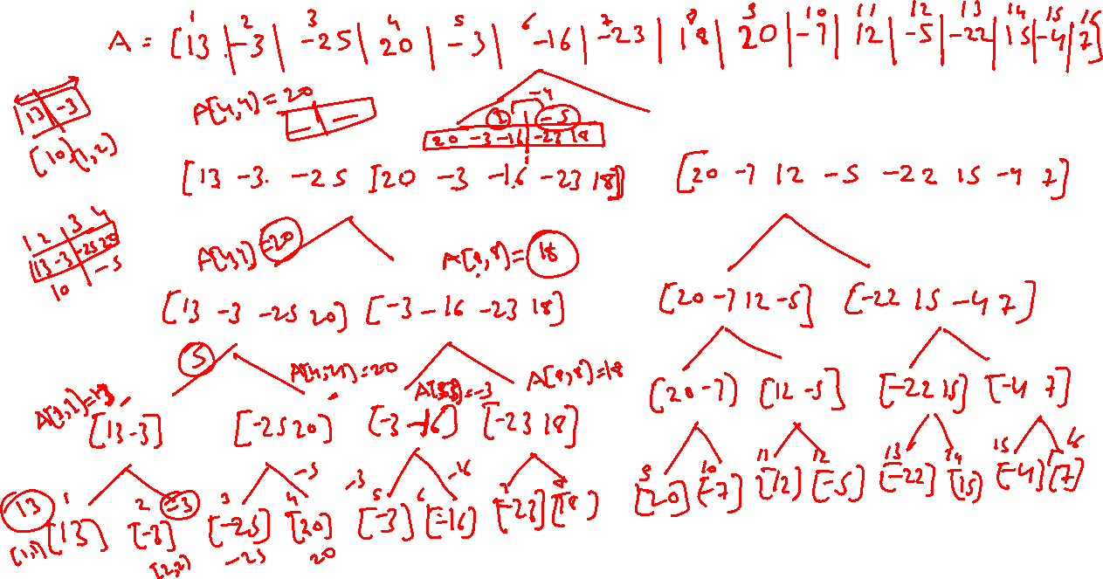


Slide 16
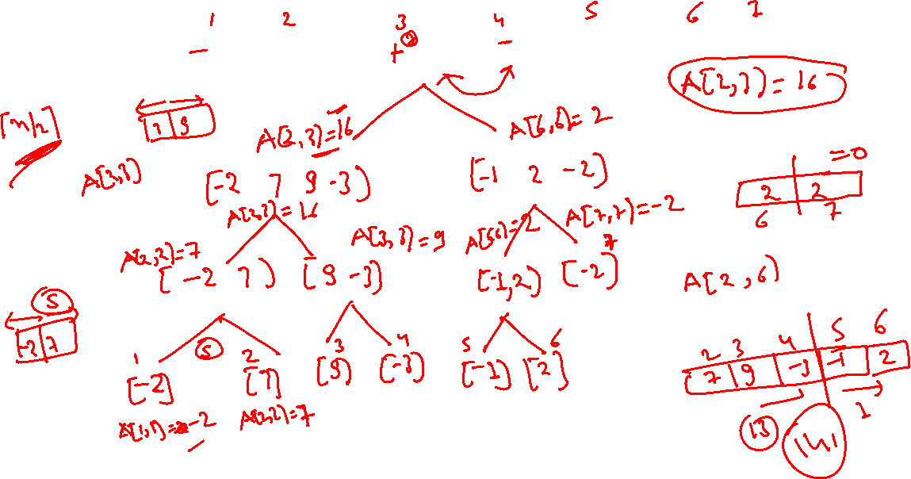


Slide 17

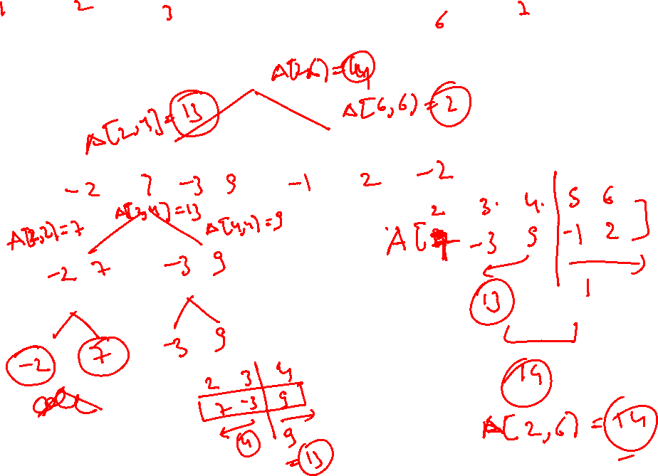

Slide 18
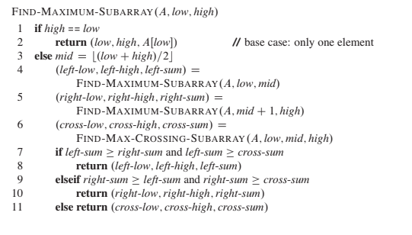
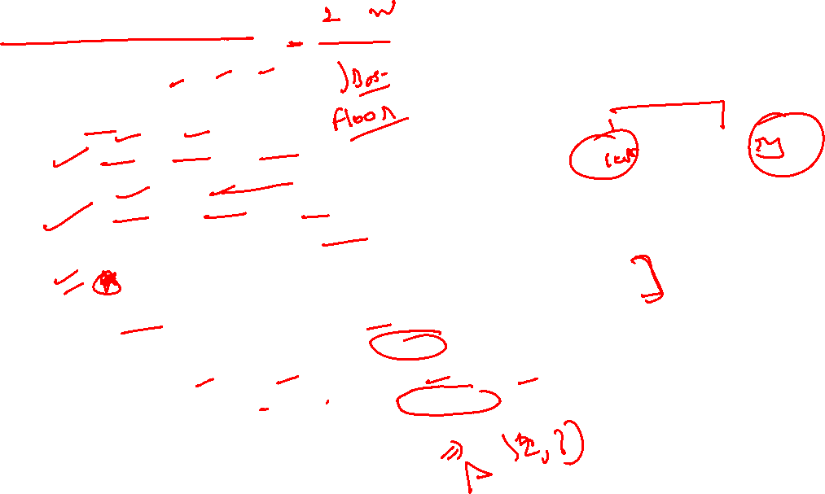

Slide 19
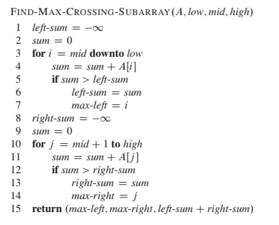
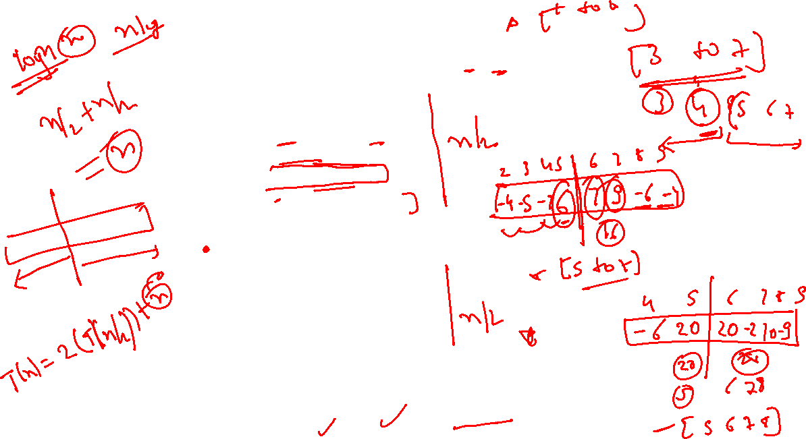

Slide 20
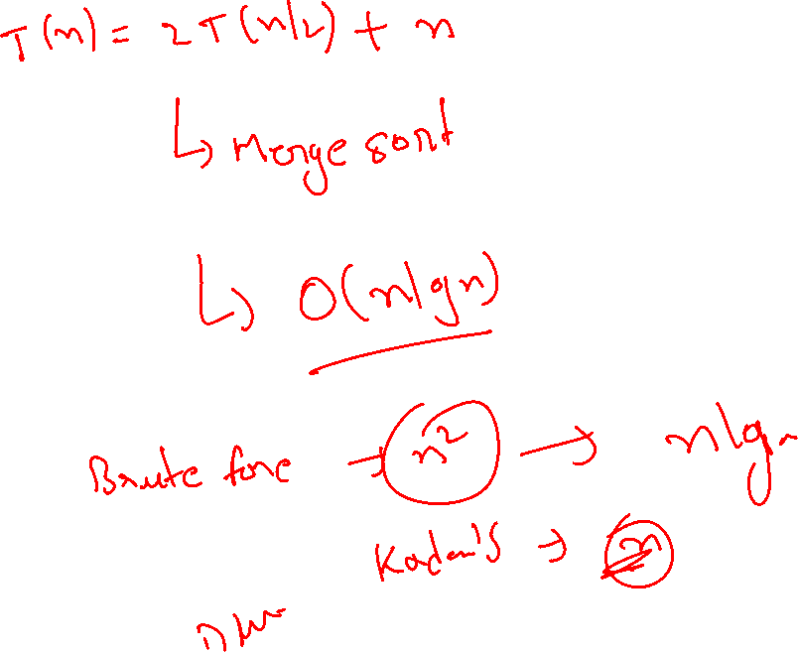

Slide 21
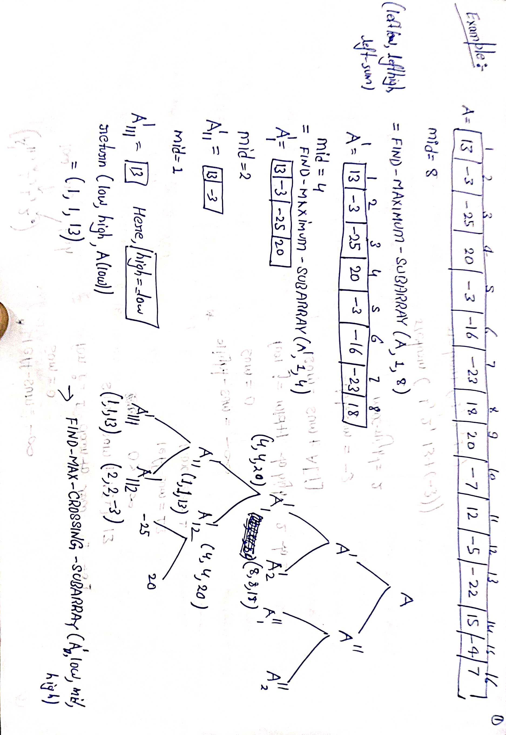

Slide 22
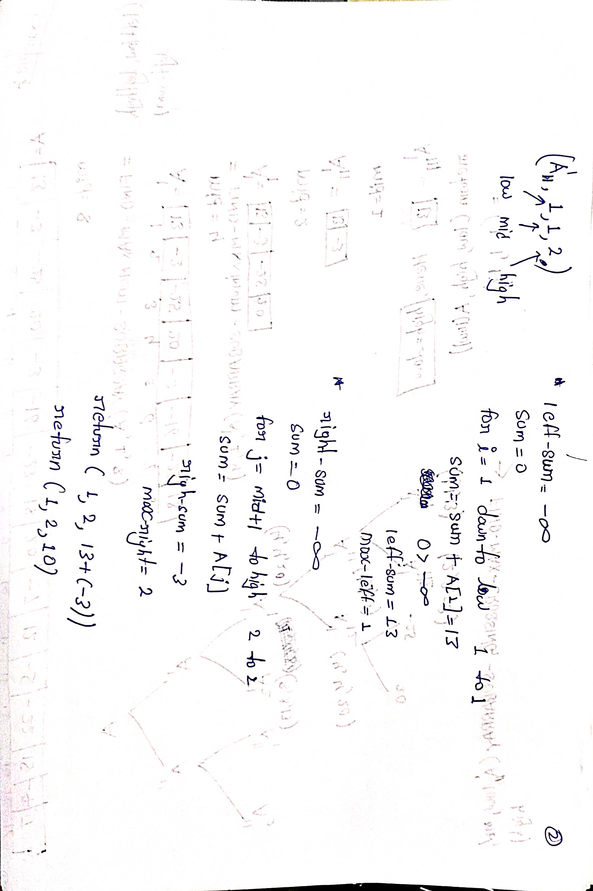

Slide 23
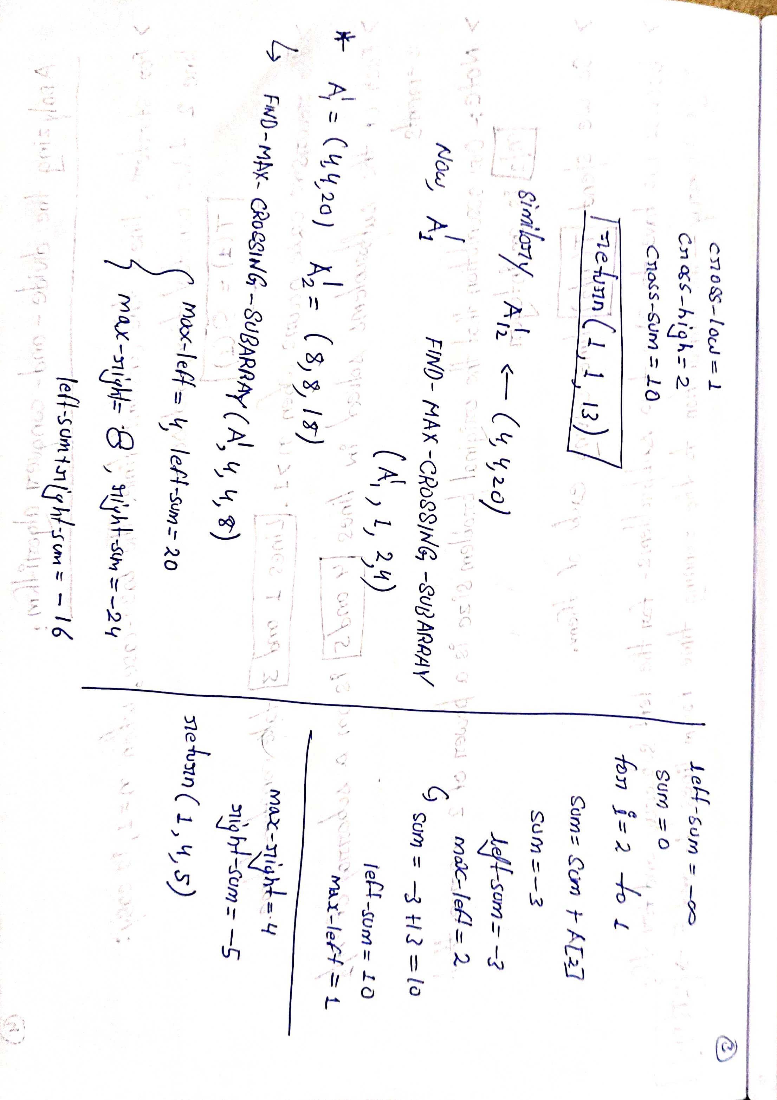

Slide 24
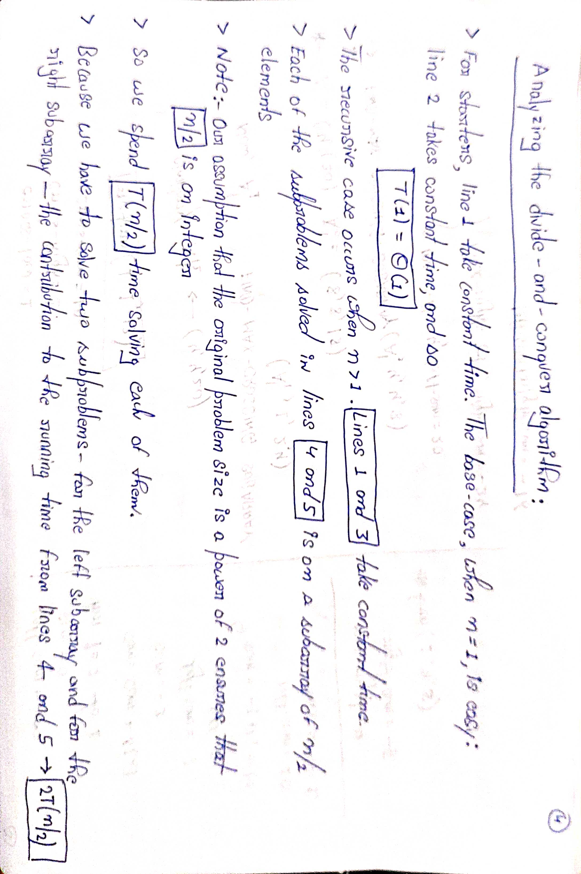

Slide 25
